Slide 1
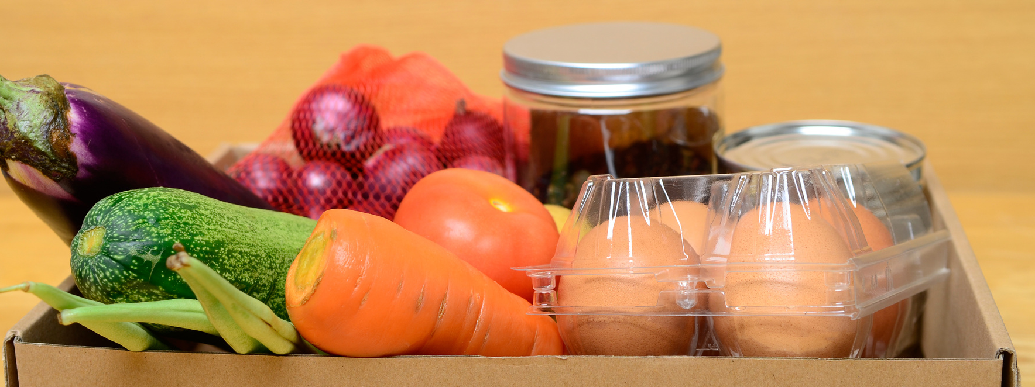
A DISTRIBUTION PARTNER OF:
WESTMINSTER RESCUE MISSION'S
WWW.WESTMINSTERRESCUEMISSION.ORG
FOOD & FUND DRIVE
TOOLKIT
A guide to conducting a food or fund drive at your business, school, church or organization to benefit the Westminster Rescue Mission's Food Program and the hundreds served in our Carroll County community every day.
@WESTMINSTERRESCUEMISSION
@WRMORG
WESTMINSTER RESCUE MISSION

Slide 2
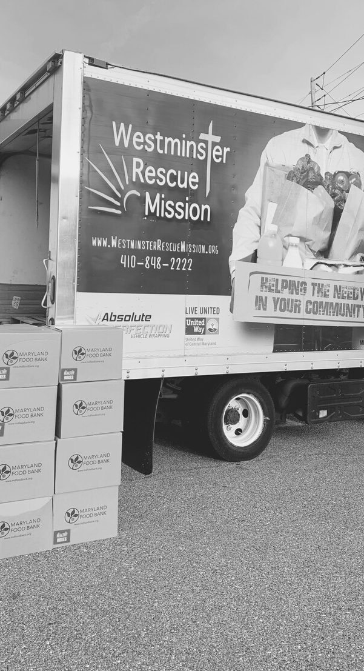
CONTACT
INFO
WESTMINSTER RESCUE MISSION'S
FOOD PROGRAM
ADDRESS:
WESTMINSTER RESCUE MISSION
658 LUCABAUGH MILL RD
WESTMINSTER, MD 21157
PHONE:
(410) 848-2222 X 146
TEXT:
410-382-9192
EMAIL:
WRMFOODPROGRAM@WESTMINSTERRESCUEMISSION.ORG
MISSION STATEMENT:
As a nonprofit Christian organization, the Westminster Rescue Mission is a community that provides clinical, physical, and spiritual resources to heal the addicted and feed the hungry. We take a holistic approach with Christ as the foundation of our work. Our two ministry programs include the Addiction Healing Center and Mission Meals Multiplied.
1.

Slide 3
Hello Community Supporter,
By considering a food or fund drive you are joining these combined efforts of along with other community partners who are dedicated to making a difference in the lives of our neighbors in need.
The food you collect does more than provide a meal for a child, senior, or family, it gives hope!
While we know that coordinating a food drive can be hard work, your efforts will have a very meaningful impact in our community, as together we stock the shelves for our distribution program, area food banks, community outreaches and more.
Together we can make difference to fill a child's backpack, help a senior in need, or neighborhood family.
THANK
YOU
Together in service,
Stephanie M. Halley
Executive Director
Westminster Rescue Mission
2.

Slide 4
FOOD/FUND DONATION PROCEDURES
COLLECT FOOD/FUNDS
Collect shelf stable food at your location and store in a “food safe" area, away from chemicals and six inches off the ground, out of the reach of pests. For perishable items reach out for more detail.
SCHEDULE DROP-OFF TIME
To ensure someone is available to receive your donation please schedule your drop-off between the following times, using the contact information provided below:
Mon-Fri from 9:15am-11:45am and from 2:15pm-3:45pm.
Email: WRMFoodProgram@westminsterrescuemission.org
Call: (410) 848-2222 x 146
Text: 410-382-9192
DROP-OFF LOCATION
LOWER PANTRY
(DROP-OFF LOCATION)
MAP
Donated food or funds can be dropped off at:
658 Lucabaugh Mill Road,
Westminster, MD 21157
Lower Pantry
MAIN
BUILDING
DIRECTIONS TO THE LOWER PANTRY:
Drive to the top of the hill, through the large parking lot and follow the drive around to the back side of the main building. Once you have arrived, please knock on the small door to the right of the garage door and someone will be there to greet you.
LOWER PANTRY
DROP-OFF
Please Note:
If the food you collect is too much for you to store at your facility, you are welcome to bring your donations in more than one trip.
3.

Slide 5
BENEFITS OF CONDUCTING A FOOD/FUND DRIVE
Team building
Promotion of your organization as a philanthropic group
Community engagement across your service footprint
Community service experiences for employees and members
Opportunity to educate your participants on the reality of hunger in our community by arranging a Mission staff member to speak to your group
GETTING STARTED
Determine if your drive will collect food, funds, or both.
Recruit a team to assist you - establish roles for individuals who will champion the drive.
Establish goals including how many pounds you want to collect or how much money you want to raise. Take this opportunity to raise awareness and educate about food insecurity in your community.
Determine a start and end date for your drive and where collection bins will be located.
Contact WRM's Food Program for advice, to arrange drop-off, and for support (see 'Contact Info' page).
Use the enclosed marketing materials (starting page on page 5) to promote your drive.
Select a prime location for your food drive. High traffic areas where the collection bins are visible are best.
Promote and launch the drive, provide reminders and congratulate participants as the drive progresses. Offer healthy competition among classrooms, departments, or teams.
Tally your results to share with your group and deliver the items or funds to the Mission (see page 3).
Document your plan and track results so that you can build on your success next year.
4.

Slide 6
Our most needed items are listed below and will be directly distributed to individuals and families in need.
FOOD
DONATION
LIST
Shelf-stable milks
Cooking oil
Peanut or nut butters
Nuts
Grains or rice
Pasta
Fruit cups
Quick or instant meals
Grab and go breakfast items
Individually packaged snacks
Bottled water
For our most up-to-date list of food donations needed, please visit our website or use the QR code below.
View our most up-to-date
list of needs here
WestminsterRescueMission.org-- > Service (tab) --> Mission Meals Multiplied
bit.ly/wrmfooddrive (Short Link)
5.

Slide 7
(YOUR ORGANIZATION'S NAME HERE)
FOOD DRIVE FOR
LOCAL FAMILIES
FLYER MOCK-UP EXAMPLE.
A DISTRIBUTION PARTNER OF:
SEE THE FOLLOWING PAGE TO CUSTOMIZE THIS FLYER (OR DOWNLOAD A WRITEABLE COPY FROM OUR GOOGLE DRIVE LINK)
in partnership with the
Westminster Rescue Mission
WWW.WESTMINSTERRESCUEMISSION.ORG
(DATE & TIME)
(LOCATION)
Learn more
about WRM's
Food Program
@WESTMINSTERRESCUEMISSION
@WRMORG
(Special instructions or messaging
from your organization here)
WESTMINSTER RESCUE MISSION

Slide 8
FOOD DRIVE FOR
LOCAL FAMILIES
A DISTRIBUTION PARTNER OF:
in partnership with the
Westminster Rescue Mission
WWW.WESTMINSTERRESCUEMISSION.ORG
Learn more
about WRM's
Food Program
@WESTMINSTERRESCUEMISSION
@WRMORG
WESTMINSTER RESCUE MISSION

Slide 9
INVITATION EMAIL OR LETTER
EMAIL OR LETTER
MOCK-UP EXAMPLE.
Dear [Name, Colleagues, Neighbors],
The [Organization Name] is participating in a food [or fund] drive to support Westminster Rescue Mission's Food Program in their goal of addressing the growing problem of food insecurity and hunger in the northern and western regions of Maryland.
Please join in this effort to help the hundreds of children, seniors, individuals, and families who are at risk of going hungry every month.
As the largest re-distributor of food in Carroll County, all donations collected from WRM's food drives directly support individuals and families in our local community.
Please forward this email to your friends, families, and colleagues, encouraging them to join-in to impact someone's life for the better. Thank you in advance for your support!
Sincerely,
[Your Name]
USE THE TEXT ON THIS PAGE TO EMAIL OR SEND A LETTER TO FOOD/FUND DRIVE PARTICIPANTS (OR DOWNLOAD A COPY FROM OUR GOOGLE DRIVE LINK)

Slide 10
THANK YOU EMAIL OR LETTER
EMAIL OR LETTER
MOCK-UP EXAMPLE.
USE THE TEXT ON THIS PAGE TO EMAIL OR SEND A LETTER TO FOOD/FUND DRIVE PARTICIPANTS (OR DOWNLOAD A COPY FROM OUR GOOGLE DRIVE LINK)
Dear [Name, Colleagues, Neighbors],
A big thank you on behalf of [Organization Name] and the Westminster Rescue Mission for donating more than XXXX (packages/ cans/ pounds) of items for our food (or fund) drive.
It was a huge success that we were able to help the many individuals and families right here in Carroll County who are battling with food insecurity like never before.
Learn more about the Westminster Rescue Mission's Food Program, how they re-distrubute more than 700,000 lbs. of food each year, serve thousands of families, work with dozens of retail stores, farms, and restaurants, and collaborate with many community partners.
We encourage you to partner with them as a volunteer or donor to continue to make a difference. Visit them at WestminsterRescueMission.org
Sincerely,
[Your Name]

Slide 11
MAKE A DONATION
FOOD/ FUND DRIVE
A DISTRIBUTIONPARTNER OF:
FOOD ITEMS
YOU MAY DONATE:
Westminster Rescue Mission's Food program provides community outreach services and a food pantry for individuals and families in need of hunger relief. It is the largest re-distributor of food in Carroll County, and provides hunger relief through our distribution network and community outreach services in partnership with dozens of area agencies and charities.
EVERY CONTRIBUTION MATTERS

Slide 12
THANK YOU
FOR ADDITIONAL INFORMATION ON THE WESTMINSTER RESCUE MISSION, OUR IMPACT, FAQS,
AND FOOD PROGRAM INFORMATION PLEASE VISIT OUR WEBSITE:
WWW.WESTMINSTERRESCUEMISSION.ORG
(410) 848-2222 X 146
@WESTMINSTERRESCUEMISSION
@WRMORG
WESTMINSTER RESCUE MISSION

