Slide 1
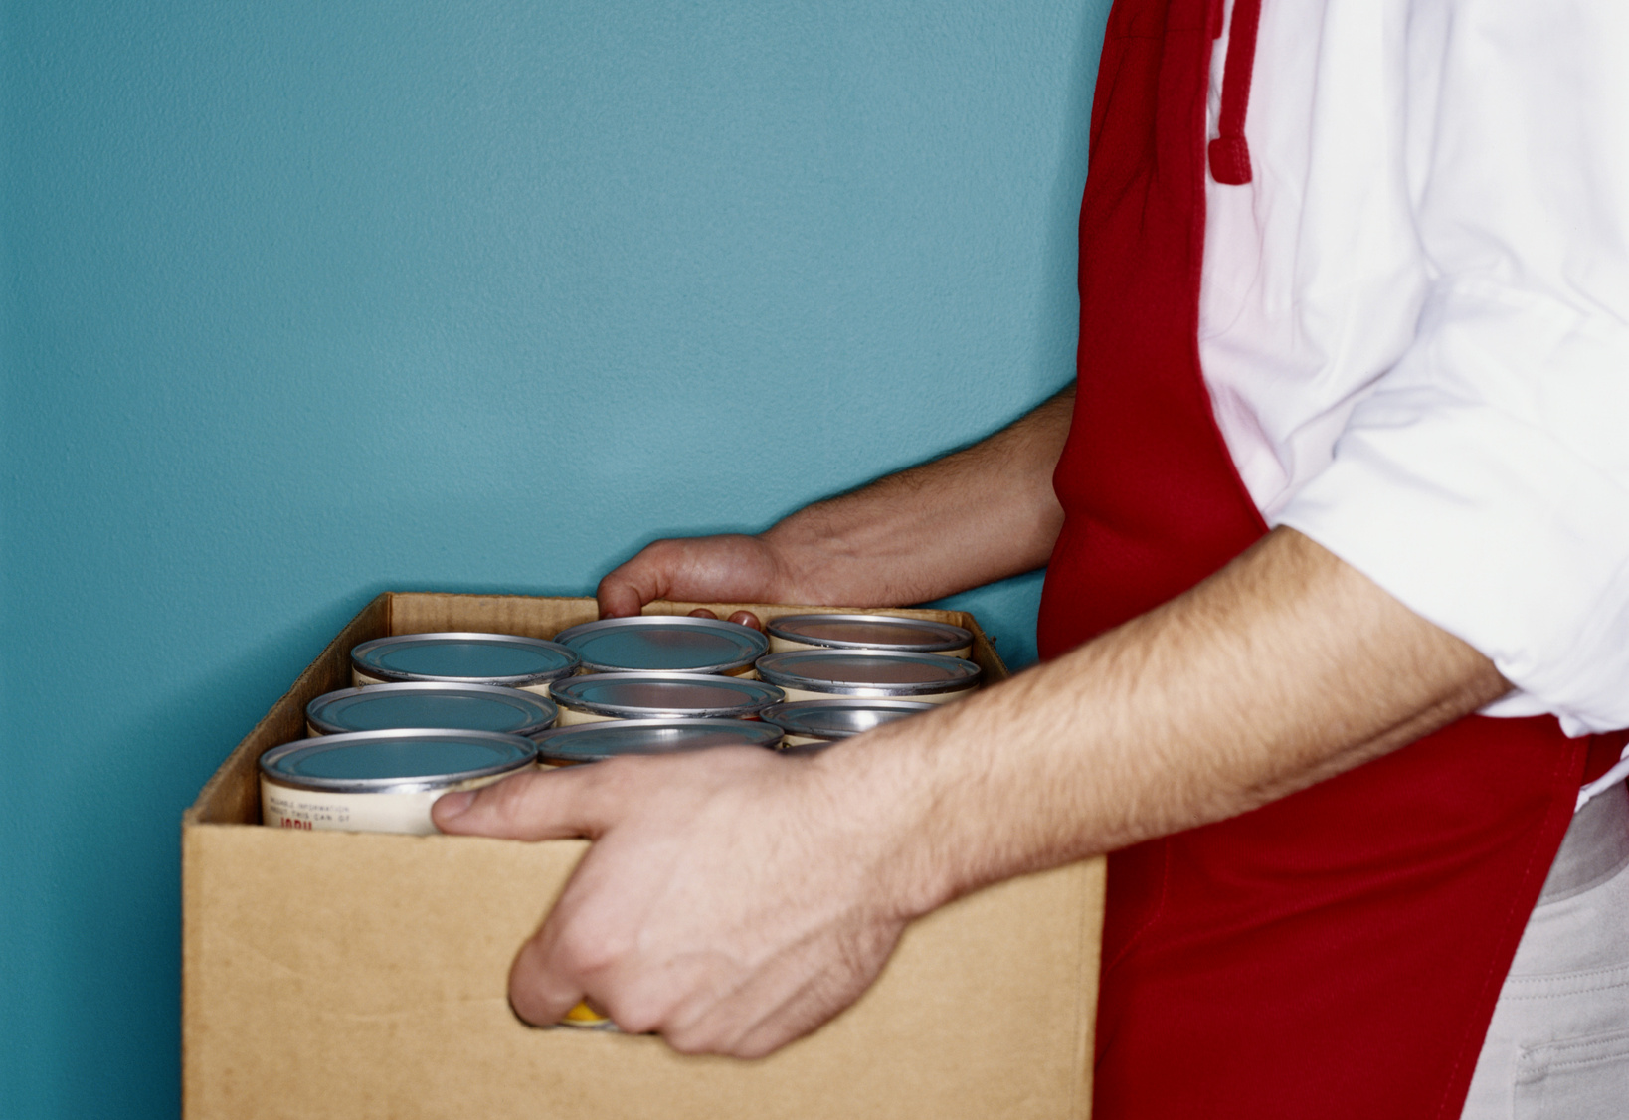
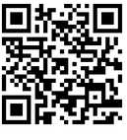
FOOD DRIVE FOR
LOCAL FAMILIES
A DISTRIBUTION PARTNER OF:
in partnership with the
Westminster Rescue Mission
WWW.WESTMINSTERRESCUEMISSION.ORG
Learn more
about WRM's
Food Program
@WESTMINSTERRESCUEMISSION
@WRMORG
WESTMINSTER RESCUE MISSION

Slide 2
INVITATION EMAIL OR LETTER
EMAIL OR LETTER MOCK-UP EXAMPLE.
USE THE TEXT ON THIS PAGE TO EMAIL OR SEND A LETTER TO FOOD/FUND DRIVE PARTICIPANTS (OR DOWNLOAD A COPY FROM OUR GOOGLE DRIVE LINK)
Dear [Name, Colleagues, Neighbors],
The [Organization Name] is participating in a food [or fund] drive to support Westminster Rescue Mission's Food Program in their goal of addressing the growing problem of food insecurity and hunger in the northern and western regions of Maryland.
Please join in this effort to help the hundreds of children, seniors, individuals, and families who are at risk of going hungry every month.
As the largest re-distributor of food in Carroll County, all donations collected from WRM's food drives directly support individuals and families in our local community.
Please forward this email to your friends, families, and colleagues, encouraging them to join-in to impact someone's life for the better. Thank you in advance for your support!
Sincerely,
[Your Name]

Slide 3
THANK YOU EMAIL OR LETTER
EMAIL OR LETTER MOCK-UP EXAMPLE.
USE THE TEXT ON THIS PAGE TO EMAIL OR SEND A LETTER TO FOOD/FUND DRIVE PARTICIPANTS (OR DOWNLOAD A COPY FROM OUR GOOGLE DRIVE LINK)
Dear [Name, Colleagues, Neighbors],
A big thank you on behalf of [Organization Name] and the Westminster Rescue Mission for donating more than XXXX (packages/ cans/ pounds) of items for our food (or fund) drive.
It was a huge success that we were able to help the many individuals and families right here in Carroll County who are battling with food insecurity like never before.
Learn more about the Westminster Rescue Mission's Food Program, how they re-distrubute more than 700,000 lbs. of food each year, serve thousands of families, work with dozens of retail stores, farms, and restaurants, and collaborate with many community partners.
We encourage you to partner with them as a volunteer or donor to continue to make a difference. Visit them at WestminsterRescueMission.org
Sincerely,
[Your Name]

Slide 4
MAKE A DONATION
FOOD/ FUND DRIVE
A DISTRIBUTIONPARTNER OF:
FOOD ITEMS
YOU MAY DONATE:
Westminster Rescue Mission's Food program provides community outreach services and a food pantry for individuals and families in need of hunger relief. It is the largest re-distributor of food in Carroll County and provides hunger relief through our distribution network and community outreach services in partnership with dozens of area agencies and charities.
EVERY CONTRIBUTION MATTERS

